Slide 1



House Price Prediction
Project Short Summary
This project covers the problem of determining optimal house prices and proposes a solution using data analytics and machine learning. The system development approach includes data collection, preprocessing, and the use of various machine learning algorithms like Gradient Boosting Regressor. The evaluation of the models is done using Mean Absolute Percentage Error (MAPE). The project's success lies in the effective deployment of the model for real-time predictions. The conclusion highlights the effectiveness of the Gradient Boosting Regressor model in predicting house prices accurately. Future improvements include incorporating additional data sources, optimizing algorithms, and expanding the system to cover multiple cities or regions.
Program Feedback
The project clearly outlines the goal of using data analytics and machine learning for real-time house price prediction. While the success of the Gradient Boosting Regressor is mentioned, including details about the data used, exploring other algorithms for comparison, and providing specific performance metrics (like MAPE value) would strengthen the impact. Additionally, mentioning any challenges faced and how future improvements address limitations (like incorporating more data) would provide a more well-rounded picture of the project.
TARANG VERMA
tarangverma60@gmail.com
Noida Institute of Engineering & Technology (NIET), Gr. Noida
#skillsbuild

Slide 2
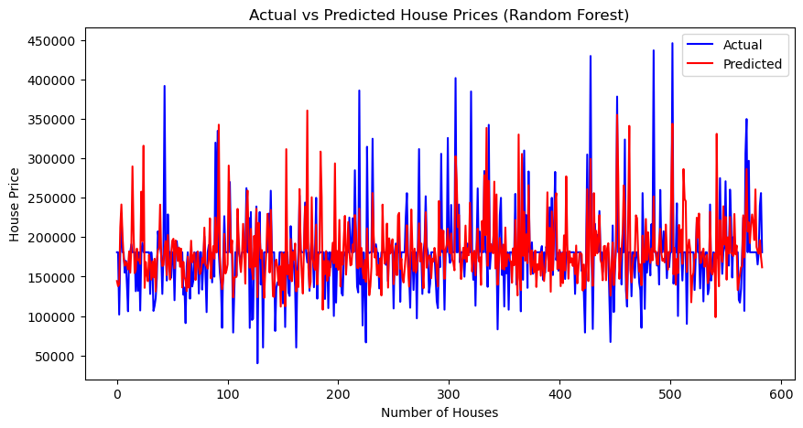
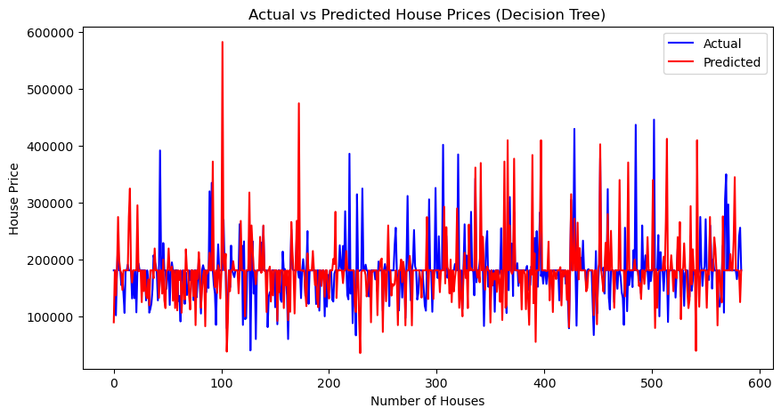

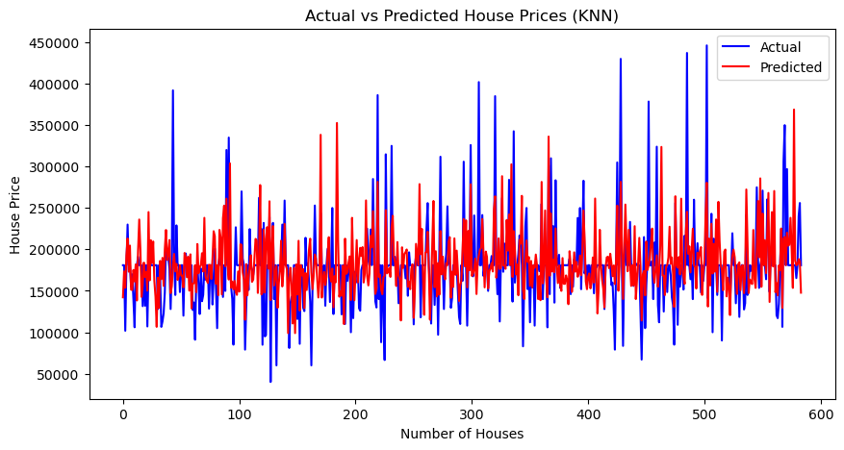
Final project Outcome Screenshot

Slide 3
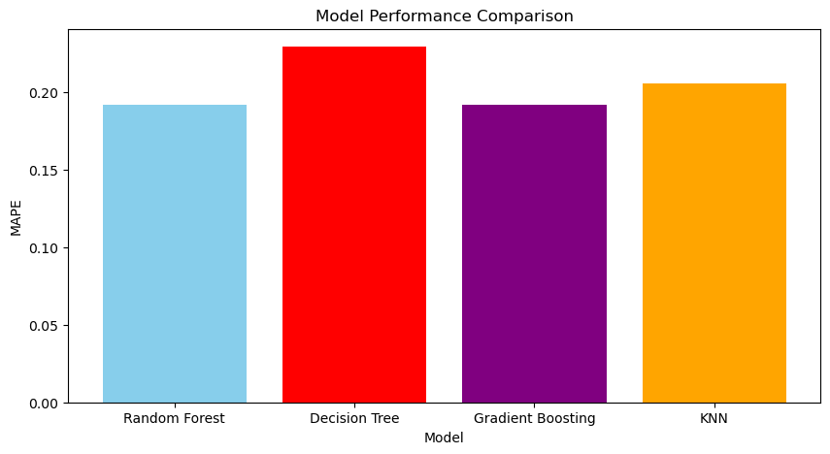
Final project Outcome Screenshot

